Slide 1
ONLINE ASSIGNMENT MANAGEMENT SYSTEM
Submitted By : Anushka Prashanth
22PMC116
Notes:
© Copyright PresentationGO.com – The free PowerPoint and Google Slides template library

Slide 2
ABSTRACT
Online assignment management system is a web based application that provides a platform for both student and teachers to manage and track assignments.Here using this platform teacher can upload the assignment related to their subject.Once they upload the assignment the registered student under that teacher will receive the mail.Teacher can add assignment and provide feedback to the students once its checked.Teacher can also add any important notice and the student will be able to see it on their dashboard.This system is convenient for both teachers and students.Since students will receive the mail they will be aware of the assignment and can do the submission without delay. Using this system

Slide 3
student can view assignment , upload assignment and view their mark. The file they upload can be viewed later when needed. To improve communication and user experience, the system incorporates a notification feature. Users receive notifications about new assignments, upcoming deadlines, grading updates, and other important events. Notifications can be delivered through email or within the system . The system also includes search and filter functionality, enabling users to quickly locate specific assignments based on various criteria such as course, deadline, or title . By implementing the Online Assignment Management System, educational institutions can centralize assignment management, automate assignment-related tasks, enhance collaboration between teachers and students, and provide timely feedback to improve the learning process.

Slide 4
REQUIREMENTS
Login
Registration
Assignment creation
Assignment submission
Assignment grading
Assignment feedback
Announcement from admin regarding college functions
Important notice by teacher
Mail notification by teacher about the assignment
View uploaded assignment
Subject wise report by teacher
View registered students
Managing profile

Slide 5
FEATURES
This system has a user friendly GUI
Using this system student and teacher can have a smooth interaction
Once teacher adds any assignment the student will receive the notification through their mail
Students can submit their assignment without fail since they receive the mail they’ll remain informed of assignment.
Teacher can give assignment sitting anywhere
Teacher can view and provide feedback
Student can upload their assignment
Student can view the news provided by the teacher
Teacher and student are able to see the announcement made by college
Since assignments are uploaded here there will not be any loss of assignment . Student and teacher can view the assignment when needed

Slide 6
TECHNICAL ASPECTS
Django:
Django is a popular Python web framework known for its simplicity and scalability. It provides a robust foundation for building web applications, including online assignment management systems. Django offers features such as URL routing, database management, authentication, and session handling, making it well-suited for complex web applications.
Third-Party Libraries:
Datetime : The datetime module is part of Python's standard library and provides classes for manipulating dates and times. It includes the datetime class for representing dates and times, date class for working with dates, time class for working with times, and timedelta class for representing time differences.
smtplib : This is a built-in library in Python that provides a simple way to send emails using the Simple Mail Transfer Protocol (SMTP). It allows you to establish a connection with an SMTP server and send emails programmatically...

Slide 7
ARCHITECTURE
Programming Language Used : Python is a versatile and popular programming language known for its simplicity, readability, and extensive range of libraries and frameworks.
Models: In Django, models represent the data structure of the application.
Views: Views handle the logic and processing of incoming requests and prepare the necessary data to be rendered by the templates.
HTML and CSS : For developing user interface.
Javascript : For including validation.
URLs: Django's URL dispatcher maps URLs to the corresponding views.
Jazmine : It is used to customize Django admin.

Slide 8
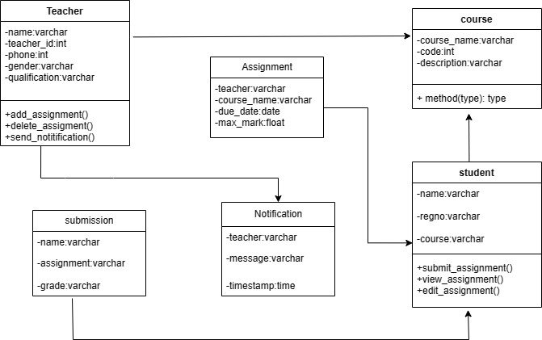
CLASS DIAGRAM

Slide 9
CHALLENGES FACED
Incorporating new features like mail functionality was a bit challenging.
Understanding and removing some errors was difficult.
Some errors occurred on migration understanding it was a bit difficult for me.
The interface design was bit challenging.
Implementing an efficient system for managing assignment deadlines and sending notifications to users was complex. Ensuring that notifications are delivered accurately and in a timely manner.

Slide 10

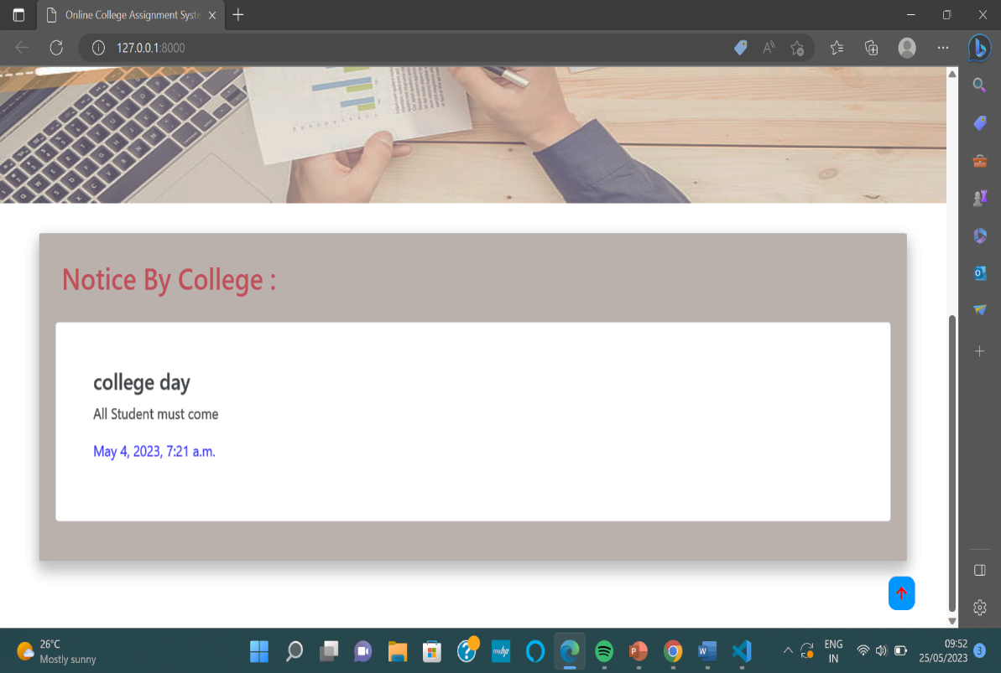
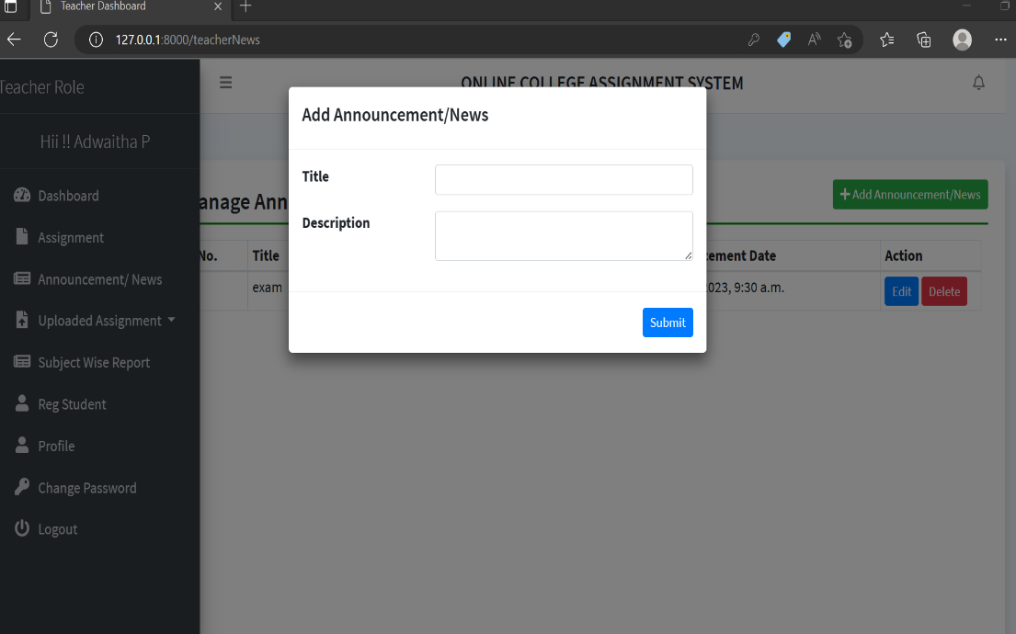
Notice By College
Here the admin shares the important message or announcements and the student and teachers can view it on their home page.
News By teacher
Here by using this feature teacher can share important information to students.

Slide 11
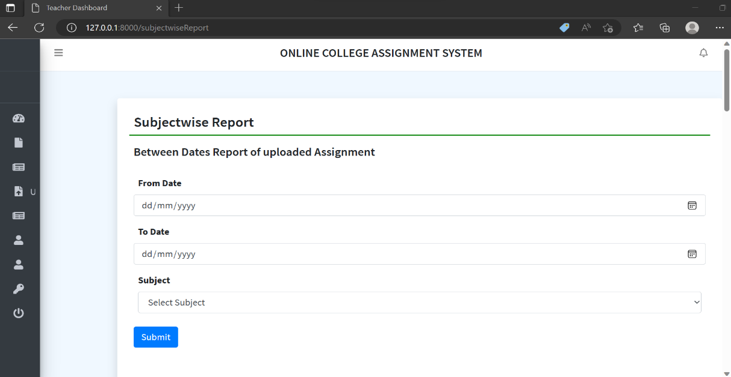
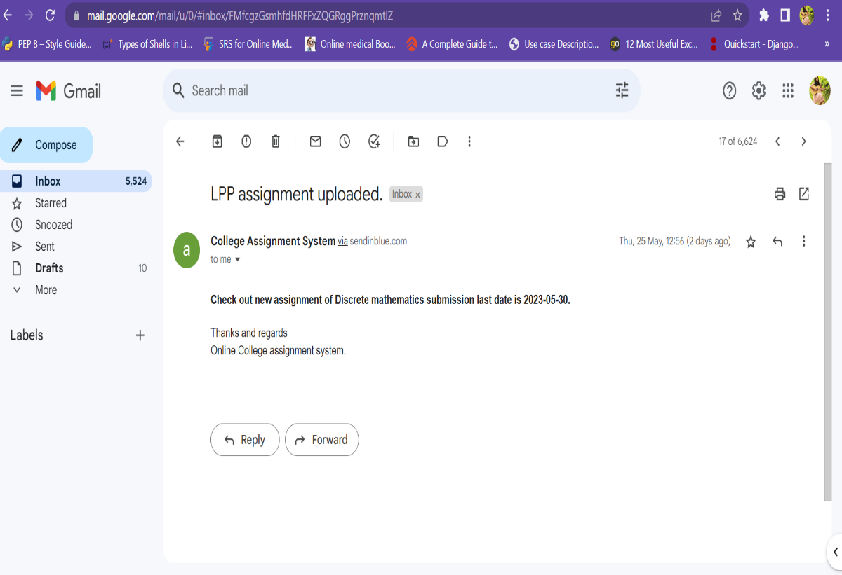
Subject wise Report
Here teacher can view the subject wise report of the assignments given by her.
Mail Notification
Once the teacher adds any assignment the registered students will receive the notification through their mail.

Slide 12
FUTURE ENHANCEMENT
The future of online assignment management systems holds great potential for significant enhancements that will revolutionize the way assignments are managed and facilitate improved learning outcomes. These enhancements may include AI-powered plagiarism detection, adaptive learning capabilities, real-time collaboration features, integration with virtual reality, advanced analytics and insights, seamless integration with learning management systems, enhanced security measures, and the utilization of natural language processing. By incorporating these advancements, online assignment management systems can provide a more personalized, engaging, and efficient learning experience for students. Educators will benefit from improved tools to detect plagiarism, customize assignments, and gain valuable insights into student performance. Furthermore, with enhanced security measures and adherence to privacy regulations, students' data will be safeguarded. As technology continues to advance, we can add even more innovative enhancements to online assignment management systems in future . These advancements will contribute to the continuous improvement of education, ensuring that students receive the best possible opportunities to develop their skills, knowledge, and critical thinking abilities.

Slide 13
CONCLUSION
A web based Online Assignment System facilitates submission of assignments by students. The system consists of modules where students could upload their answer. Notification are sent to students when new assignment is added . Teachers can check the assignment and provide necessary feedbacks. Students can have only limited access . Using this loss of assignments cane be managed ,that is in traditional method the assignment paper can be gone missing . Here teachers and student doesn’t have to face any such issues , their files remain safe . This system is very simple to use . Student and teacher can also view important announcements made by the college on their home page . This system is very well suited for every institution as assignment handling task can be made easier for both teachers and students . This project will bring forth a new era of better equipped online assignment management platform.

Slide 14
REFERENCES
http://ir.aiktclibrary.org:8080/xmlui/bitstream/handle/123456789/3608/16CO16.pdf?sequence=1&isAllowed=y
https://itsourcecode.com/free-projects/python-projects/online-assignment-submission-system-in-django-with-source-code/
https://youtu.be/OLrC4J2-pvk
https://youtu.be/vQLwo49nE4o
https://youtu.be/TAg4eYLkZfk
https://youtu.be/ye5iECq7HNs

Slide 15
THANK YOU

